Slide 1
Why become Catholic and why do it now?
Deacon Ken Crawford
4/29/26

Slide 2
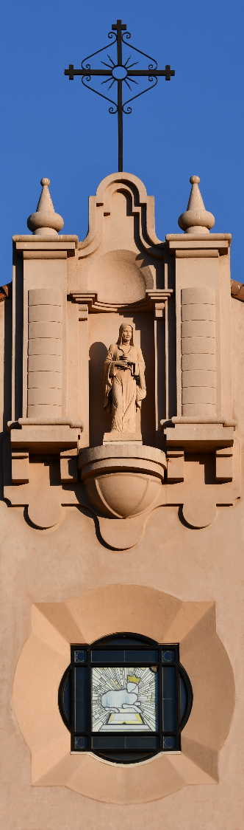
Overview
Because it is true
  Overview of what we believe
  Evidence for that belief
Because your life will be better
  God loves us
  Following His teachings brings us joy and contentment
Because it will make the world better
  God loves the world
  Following His teachings makes the world better
What the conversion process looks like
  OCIA

Slide 3
What we believe
(the short, short version)

Slide 4
One God who is the creator of everything
God exists outside of space and time
  There is only one God
    Omnipotent (all powerful)
    Omniscience (all knowing)
    Omnipresent (present everywhere)
    Omnibenevolent (all loving)
God brought all of creation into being through an act of his will
  He ‘Spoke’ it into existence
What He created is fundamentally Good

Slide 5
God created Mankind in His image
Human beings are special within creation
  We have a soul that will continue to exist after we die
  We are persons with free will
  He loves us in a special way
Free will means we can disobey God
  And from the very first human beings we have done so
  To our own demise
  This is called Original Sin
God knew this would happen and from the beginning had a plan

Slide 6
God chose a people to fulfill His plan
Started with Abraham
  God revealed Himself to Abraham
Further revealed and clarified
  Over the centuries God revealed Himself further
  So that the Jewish people would understand God better
Basic timeline
  Abrahamic people in Holy Land
  Enslaved and then freed by God from Egypt
  Grew into nation upon return to Holy Land
  Exiled when the disobeyed God
  Returned to Holy Land to fulfill His plan

Slide 7
God sent us His only Son to redeem us
Born of a Jewish virgin in the Holy Land
  Father is God the Father
  Mother is Mary (human being)
Upon adulthood Jesus shared the truth
  Chose specific people to be his closest followers (Apostles)
  Performed many miracles
He was killed (died for our sins)
  By Jewish and Roman authorities
  But all humanity is responsible
Rose from the dead
  Revealed Himself to His Apostles – Conquered death and sin

Slide 8
God sent the Holy Spirit to guide and protect us
Jesus had prepared Apostles for His Death
  They would become the leadership of His Church
Jesus gave them final wisdom before His Ascension
At Pentecost the Apostles received the gift of the Holy Spirit
  This gift guides and protects the Church to this day

Slide 9
The Catholic Church is God’s Church on Earth
Pope Leo is the 267th successor to St. Peter
  St. Peter was the leader of the Apostles and the first Pope
  Unbroken line of Apostolic Authority
Bishops are successors to the Apostles
  Bishop Soto here in Sacramento was ordained by a bishop who was ordained by a bishop who was ordained by a bishop (repeat many times) who was ordained as a bishop by an Apostle
Bishops in union with Pope lead and protect Christ’s Church

Slide 10
Evidence for our beliefs

Slide 11
Caveat: Evidence not proof
Proofs are remarkably hard
  Even Science has assumptions
    Our observations are real and trustworthy
    We live in an ordered universe
    The order does not change over time
    God does not frequently interfere with the order
But evidence of our beliefs are abundant
  And what we believe is in accord with all wisdom
  We embrace science and other methods of the discovery of truth
We are a people of Revelation and Reason
  It is by God’s grace that we have received His Revelation
Homework: Read ‘Fides et Ratio’ (Faith and Reason)

Slide 12
One God who is the creator of everything
Creation Exists
  Something had to create it (Uncaused Cause and the Necessary Being)
Creation appears designed
Creation is in Motion
  Something must set and keep it in motion (Uncaused Mover)
We understand Good and Bad
  Only makes sense with The Absolute Standard
Homework: Read St. Aquinas’ proof for God

Slide 13
God created Mankind in His image
Human beings are clearly different than other creatures
But we also clearly have a corrupted will
  Often do things that are against our own interests
Homework: Read G.K. Chesterton’s Orthodoxy
  Particularly Chapter 1 – “the Maniac”

Slide 14
God chose a people to fulfill His plan
History of the Jewish People tells this story
Read the Old Testament
  Important Note: One need not accept the Bible as the inerrant Word of God for it to be a credible witness of historical reality
  Much of the Old Testament are confirmed by
    Other historical records
    Archeology
Homework: Read ‘Walking with God’ by Tim Gray and Jeff Cavins

Slide 15
God sent us His only Son to redeem us
Read the Gospels
  Accounts of eyewitnesses to these events
  Again: Don’t need to accept as “scripture” to be credible account
  Notice lack of perfection in text (real history isn’t a fairy tale)
Evidence from other sources
  Flavius Josephus (37-100 AD) – Jewish historian
  Cornelius Tacitus (56–120 AD) – Roman senator
  Pliny the Younger (61–113 AD) – Roman Governor in ‘Turkey’
Homework: Read Brant Pitre’s “The Case for Jesus”

Slide 16
God sent the Holy Spirit to guide and protect us
Something happened to the Apostles
  In hiding after Jesus’ execution
Ask yourself: What caused them to be so bold?
  Willing to die for the faith
Homework: Read the Gospel of Luke and Acts of the Apostles

Slide 17
The Catholic Church is God’s Church on Earth
Again, history attests to these truths
World’s longest lasting “human” institution
  Oldest government: San Marino – 1600 AD
  Oldest monarchy: Japan – 4th century (or UK 9th Century)
  Oldest company: Kongō Gumi (6th cent.) – recently acquired
Many sources for this truth
  Church Fathers
  Secular historians
Homework: St. Irenaeus, Against Heresies, Book III, Chapter 3

Slide 18
Bonus: Truths of Church
Bishop Fulton Sheen
  "There are not one hundred people in the United States who hate The Catholic Church, but there are millions who hate what they wrongly believe to be the Catholic Church."
Objections people have
  Church has done lots of bad things: Yup – that’s true. We are a Church of sinners, from the Pope to the People in the pews
    That’s why we need protection of Holy Spirit to reform and correct us
    There is no perfect Church
  Church contradicts scripture: Not true. Scripture is immensely complicated and Church wrestles with it all.
    Don’t be fooled by cherry picked verses!
  Church has bad teaching X, Y and Z
    Learn what the Church actually teaches
    If time allows - at the end I will address any issues you have

Slide 19
Being Catholic will improve your life

Slide 20
Many graces to be received
Sacraments
  Baptism and Confirmation
  Eucharist and Reconciliation/Confession plus Anointing of the Sick
  Marriage and Holy Orders
Living morally is for our own good
  Self evident
  It is in giving that we receive
Helps us reject bad ideas
  Fundamentalism vs. “Scientism”
  Nihilism vs. Gnosticism
  Individualism vs. Collectivism
Support and guidance of the community
  Where two or more are gathered in my name

Slide 21
Baptism
Be reborn!
We die to our sinful ways
  Drowning in sin
We rise to new life
  Come out of the water cleaned and united to Christ
Permanently changes our soul

Slide 22
Eucharist and Confession
Be sustained!
Receiving the Body and Blood of Christ gives us many great graces
  Food for the journey
Confession is for us!
  Not a punishment
  A gift to be reconciled
  More important the longer we’re Catholic

Slide 23
Marriage
Societal sense of marriage is highly corrupt
  Contractual
  Temporary / dissolvable
  “What am I getting?”
True love is sacrificial
  Think about how we love our kids
    We don’t “divorce” our kids
  Need to love our spouse the same way
Practical goods
  Not good to be self-centered
  Trust is spouse bears fruit
Good marriages lead to much better lives

Slide 24
Overcoming sin
Principles of the faith lead us to good places
  Take care of ourselves
  Prevent ourselves from doing “stupid” things
  Live in a principled way
Recognize that temptation to sin is real
  Must be fought

Slide 25
In Giving we Receive
Live selflessly and be more happy
Both self evident and counter intuitive at the same time
Bonus encouragement: So many of the ideas of the Church have been confirmed to be for our own good by modern science

Slide 26
Avoid Bad ideas
Fundamentalism vs. “Scientism”
  Fundamentalism: Hyper trusting in portions of revelation despite reason suggesting there are limits of ideas
  “Scientism”: Turning Science into an ideology/religion that extends beyond what science is capable of revealing
Nihilism vs. Gnosticism
  Nihilism: There is no meaning
  Gnosticism: Meaning is “hidden knowledge”
Individualism vs. Collectivism
  Individualism: Ignorant of need for and reliance on community
  Collectivism: Ignores dignity of each person

Slide 27
Being Catholic will help the world

Slide 28
Best ideas came from God
Living well will help the world
  Honesty
  Integrity
  Selflessness
Rights of Man
  Right to Life
  Right to Bodily Integrity
  Right to basic necessities
  Freedom of Conscience
  Equality
Best institutions
  Universities
  Hospitals
  Science – Came out of middle ages and Catholic universities

Slide 29
OCIA

Slide 30
Process for becoming Catholic
Initial Phase: Wednesday’s @ 7:30 PM
Rite of Election
Rite of Initiation
Beginning of Lent
Mystagogy & Neophyte Year
Rite for Entrance
Easter Vigil

Slide 31
Conclusion

Slide 32
Conclusion
What we believe is true
And it will make you better
And it already has and will continue to make the world a better place
And you can start right away

Slide 33
Homework
Read ‘Fides et Ratio’ (Faith and Reason)
Read St. Aquinas’ proof for God
Read G.K. Chesterton’s Orthodoxy Ch. 1
Read Brant Pitre’s “The Case for Jesus”
Read ‘Walking with God’
Read Luke and Acts of the Apostles
Read Against Heresies, Book III, Chapter 3

Slide 34
Additional Information
Webpage:
  http://deaconken.org
E-mail:
  ken@deaconken.org
Slides:
  https://deaconken.org/blog/why-believe/
Other presentations:
  https://www.youtube.com/DeaconKenCrawford
  I’ve done about 25 hour-long lectures on various topics
OCIA:
  Every Wednesday night at 7:30 PM in the St. Matthew room
  Start whenever you are ready

Slide 35
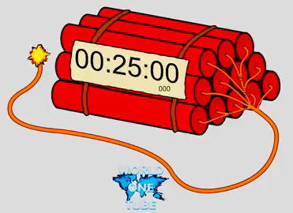
Questions?

